Slide 1
Unit 3 review

Slide 2
1) The theory that organisms have new traits that their ancestors did not have:
Acquired traits
Descent with modification
Homologous structure
All of these

Slide 3
2) Which of the following is evidence that supports the theory of evolution?
Humans are more developed than other organisms
Darwin’s book
The fossil record
The science textbook

Slide 4
3) When 2 or more species evolve in response to each other:
Coevolution
Convergent evolution
Divergent evolution
Punctuated equilibrium

Slide 5
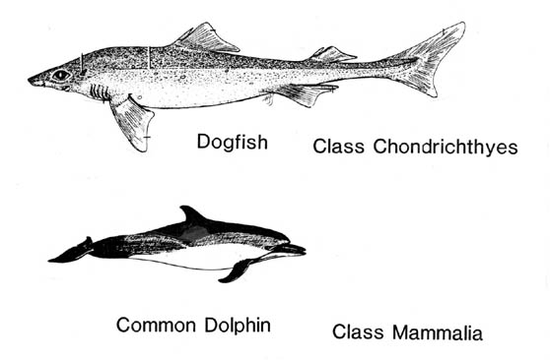
4) The picture below demonstrates:
Coevolution
Convergent evolution
Divergent evolution
Punctuated equilibrium

Slide 6
5) Which of the following explains why there is no genetic equilibrium in nature? (No Hardy-Weinberg)
There are no mutations in nature
All mating between organisms is random
There is no natural selection
Migration into/out of populations occurs frequently

Slide 7
6) Which of the following is an example of genetic drift?
New organisms move into a population
The birth rate increases
Organisms die of old age
A fire kills off half of a population

Slide 8
7) Which of the following is most likely to cause speciation?
A group of organisms becomes isolated from the rest of the population by a new river forming
A group of organisms within a population suddenly dies off.
Humans destroy the habitat of a population
Two different animals are bred together to produce a hybrid

Slide 9
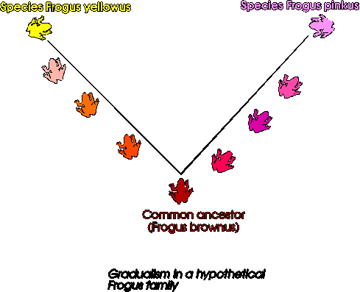
8)The picture demonstrates which rate of evolution?
Punctuated equilibrium
Hybridism
Gradualism
Spontaneous generation

Slide 10
9) In a particular environment having very large feet is an advantage over having medium or very small feet. This demonstrates:
Stabilizing selection
Disruptive selection
Extreme selection
Directional selection

Slide 11
10) The man who proposed natural selection as the mechanism for evolution:
Darwin
Mendel
Watson
Redi

Slide 12
Unit 3 review
Check your answers

Slide 13
1) The theory that organisms have new traits that their ancestors did not have:
Acquired traits
Descent with modification
Homologous structure
All of these

Slide 14
2) Which of the following is evidence that supports the theory of evolution?
Humans are more developed than other organisms
Darwin’s book
The fossil record
The science textbook

Slide 15
3) When 2 or more species evolve in response to each other:
Coevolution
Convergent evolution
Divergent evolution
Punctuated equilibrium

Slide 16
4) The picture below demonstrates:
Coevolution
Convergent evolution
Divergent evolution
Punctuated equilibrium

Slide 17
5) Which of the following explains why there is no genetic equilibrium in nature? (No Hardy-Weinberg)
There are no mutations in nature
All mating between organisms is random
There is no natural selection
Migration into/out of populations occurs frequently

Slide 18
6) Which of the following is an example of genetic drift?
New organisms move into a population
The birth rate increases
Organisms die of old age
A fire kills off half of a population

Slide 19
7) Which of the following is most likely to cause speciation?
A group of organisms becomes isolated from the rest of the population by a new river forming
A group of organisms within a population suddenly dies off.
Humans destroy the habitat of a population
Two different animals are bred together to produce a hybrid

Slide 20
8)The picture demonstrates which rate of evolution?
Punctuated equilibrium
Hybridism
Gradualism
Spontaneous generation

Slide 21
9) In a particular environment having very large feet is an advantage over having medium or very small feet. This demonstrates:
Stabilizing selection
Disruptive selection
Extreme selection
Directional selection

Slide 22
10) The man who proposed natural selection as the mechanism for evolution:
Darwin
Mendel
Watson
Redi

